Slide 1
BOLTON COUNCIL BUDGET 2019-21
November 2018

Slide 4
We’ve delivered this in spite of:
Budget pressures since 2011/12 of about £185m:
lost £107m of government grants
inflation costs of £34m
an extra £44m needed to meet increasing demand (e.g. adult social care)
About £155m of cuts already delivered, plus extra income of around £30m
We have £155m less to spend than in 2011/12
1,721 fewer jobs (1,419 FTEs) since 2011, through voluntary means

Slide 5
Our strategic approach to meeting the financial challenge
A strong approach to encouraging investment in Bolton
more businesses = more business rates
More people living/employed in Bolton = more money spent in Bolton
Increasing housing provision
more housing = more council tax
but we recognise that this is also challenging
Using reserves to give more time to find the savings – this is one-off money, and is reducing
The front line and services for vulnerable people protected as far as possible
Notes:
Provide details of how much this has reduced – from the budget report
Reserves – in March 2016 we had £203,562,000 of reserves. By the end of 2018/19 we will have £149m,
Type of Reserve 31/3/18 31/3/19
£m £m
Reserves we can’t touch (schools etc) 4 14
Reserves we must have (audit requirements) 11 11
Reserves to support the 19-21 budget process 25 16
Reserves for known insurance claims/self insurance 20 18
Reserves to fund our existing capital programme 77 62
Reserves set aside for revenue commitments (ICT etc) 40 28
Total 177 149

Slide 6
Our strategic approach to meeting the financial challenge
Transforming how we deliver services - more efficient and customer focused
Working with partners in the public, community, and voluntary sector to redesign services around our customers and join up our approaches
Identifying ways to bring in income
Developing alternative models
Looking at every penny we spend

Slide 7
The proposal
We have to find another £31.5m of cuts over the next two years
Report to Cabinet on 3rd December proposing that:
We increase council tax by 2.5%, made up of 1% Adult Social Care levy and 1.5% general levy
We use revenue reserves totalling £8m to balance the 2019-21 budget
Meaning that Directorates must find further savings totalling £23.5m:
Chief Executive’s/Corporate £4m
Place £5.7m
People (inc Public Health) £13.8m
and a further £8m reserves to allow savings to be phased in over the two-year period
A minimum of 124 jobs at risk of redundancy - we won’t know the exact number until the detailed proposals are brought forward.

Slide 8
All of this is subject to:
Consultation
Mayoral precept decision which may add a further levy to cover:
Police & Crime Commissioner precept
Mayoral General Precept (inc Fire Services)
Fair Funding Review
Any other unplanned contingency or events
Notes:
We’ll know the outcome of the decision on the mayoral precept in time for the final budget report to Council in February 2019 for 2019-20
Fair Funding Review: As part of the 2016/17 finance settlement it was announced there would be a Fair Funding Review of authorities’ funding needs, initially to be implemented in 2019/20. Due to the 2017 general election, in September 2018, it was announced that such a review would now be implemented in 2020.

Slide 9
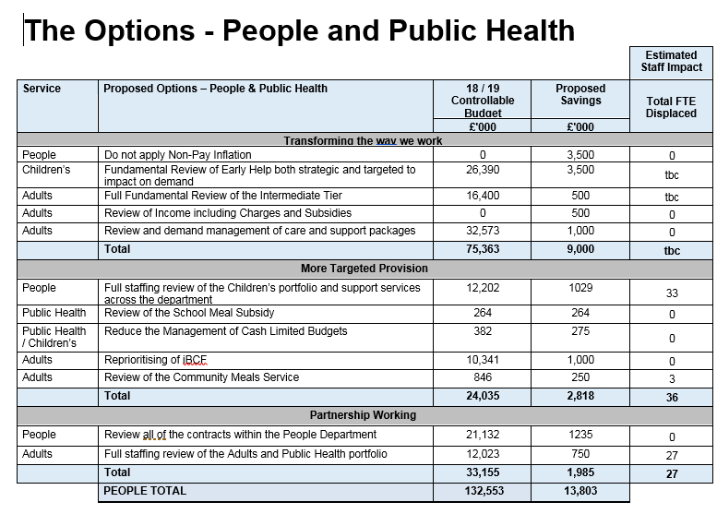

Slide 10
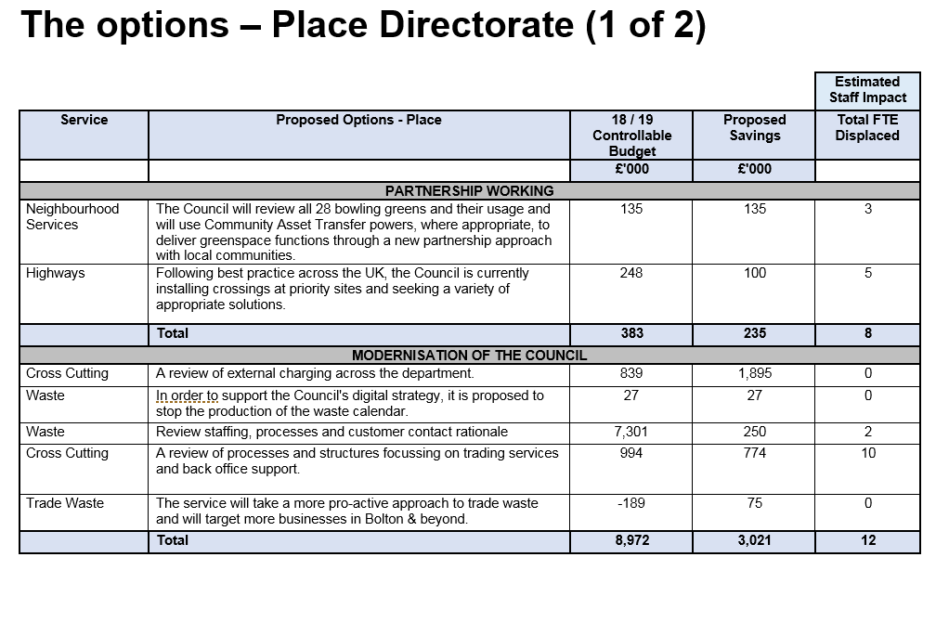

Slide 11
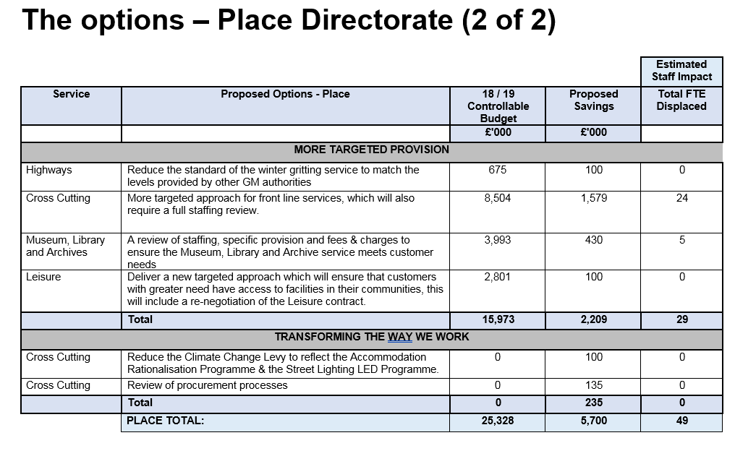

Slide 12
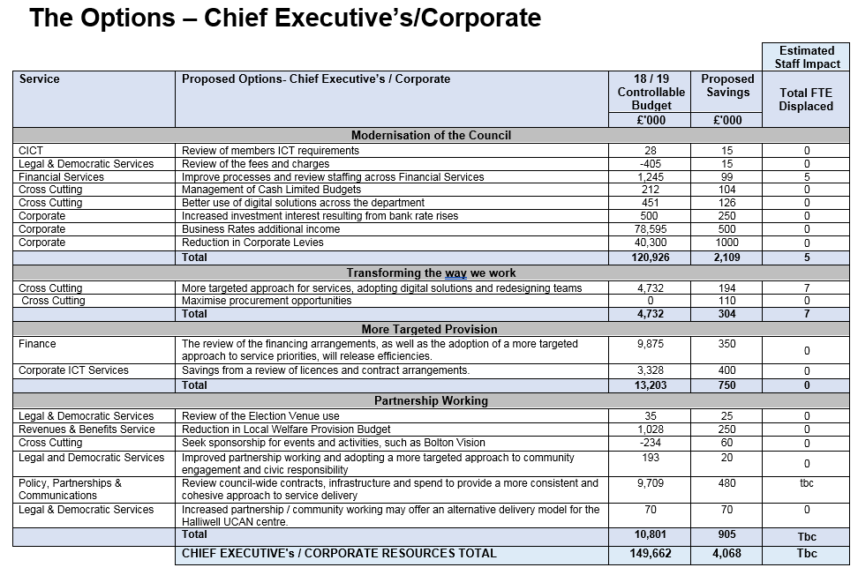

Slide 13
Consultation and Next Steps
Report published on CMIS today (23/11). Consultation starts on 3rd December and will end on 14th January 2019.
Staff, the public, elected members, trade unions, partners, non-domestic business rates payers and other stakeholders will be able to give their views
A final report, taking on board consultation feedback, will go to Cabinet 11th February and full Council 20th February 2019
Detailed savings options will be brought forward over the following two years

